Slide 1
L E C T U R E
3
SOFTWARE PROCESS
Notes:
This repository of slides is intended to support the named chapter. The slide repository should be used as follows:
Copy the file to a unique name for your course and unit.
Edit the file by deleting those slides you don’t want to cover, editing other slides as appropriate to your course, and adding slides as desired.
Print the slides to produce transparency masters or print directly to film or present the slides using a computer image projector.
Each slide includes instructor notes. To view those notes in PowerPoint, click-left on the View Menu; then click left on Notes View sub-menu. You may need to scroll down to see the instructor notes.
The instructor notes are also available in hardcopy as the Instructor Guide to Accompany Systems Analysis and Design Methods, 5/ed.

Slide 2
Previous session
OVERVIEW OF THE SOFTWARE PROCESS.
The roadmap to building high quality software products is software process.
Software processes are adapted to meet the needs of software engineers and managers as they undertake the development of a software product.
A software process provides a framework for managing activities that can very easily get out of control.
Different projects require different software processes.
The software engineer's work products (programs, documentation, data) are produced as consequences of the activities defined by the software process.
The best indicators of how well a software process has worked are the quality, timeliness, and long-term viability of the resulting software product.

Slide 3
RAD Model
Rapid Application Development
“high speed” adaptation of LSM (Linear sequential model). If requirements are well understood and project scope is constrained--- short cycle
(60-90 days)
Steps:
  Business modeling
  Data modeling
  Process modeling
  Application generation
  Testing and turnover
What Information drives the business process?
What Information is generated?
Who generates it?
Where does the Information go ?
Who process it?
Define Object,attribute,relation and class
RAD assumes the use of fourth generation techniques. Rather than creating software using conventional third generation programming languages—In all cases, automated tools are used to facilitate construction of the software.
Processing descriptions are created for adding,modifying,deleting,or retrieving a data object.
Rapid Application and Development (RAD) Model (makes heavy use of reusable software components with an extremely short development cycle)

Slide 4
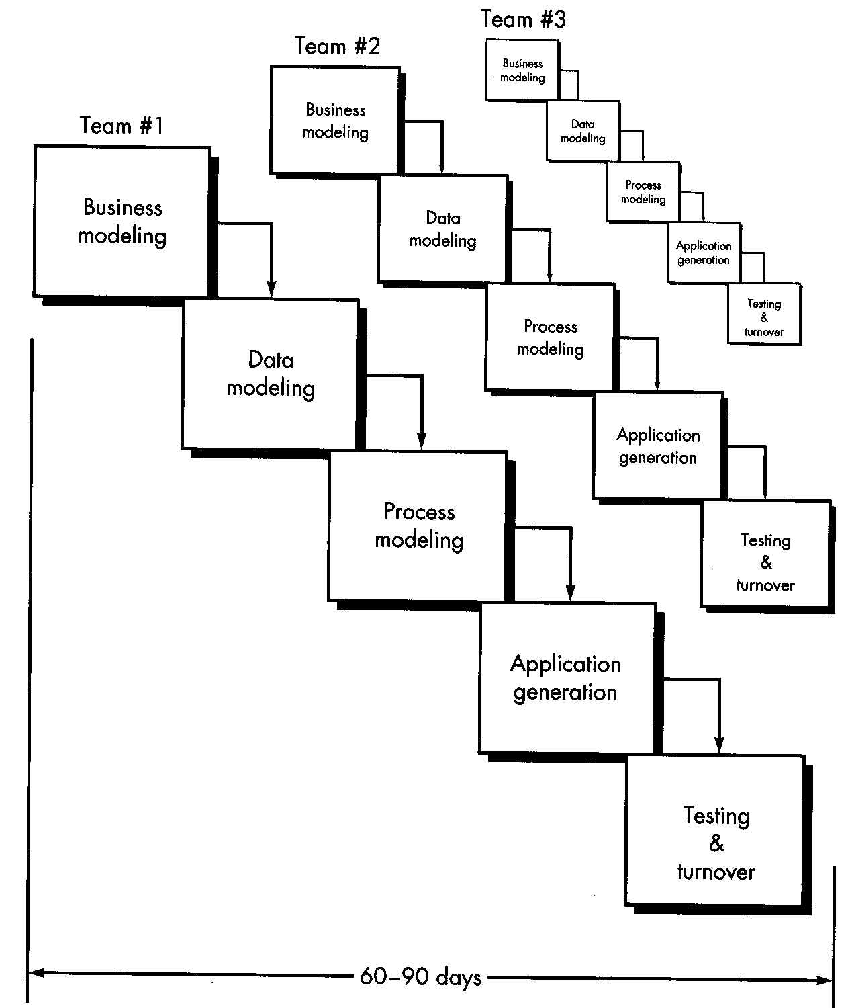
Rapid Application
Development (RAD)

Slide 5
RAD Model
Challenges/drawbacks:
  For large projects, sufficient human resources are needed for rapid cycle
  Strong commitment from developers and customers
  Not all types of applications are appropriate for RAD. If a system cannot be properly modularized --
  RAD is not appropriate when technical risks are high.
  Reusability sometimes implies loss of performance

Slide 6
The Incremental Model
Linear sequential, with iterative prototyping
“Core product” vs. incremental enhancements
Each increment operational
Useful when human/machine resources are limited
Incremental Model (delivers software in small but usable pieces, each piece builds on pieces already delivered)

Slide 7
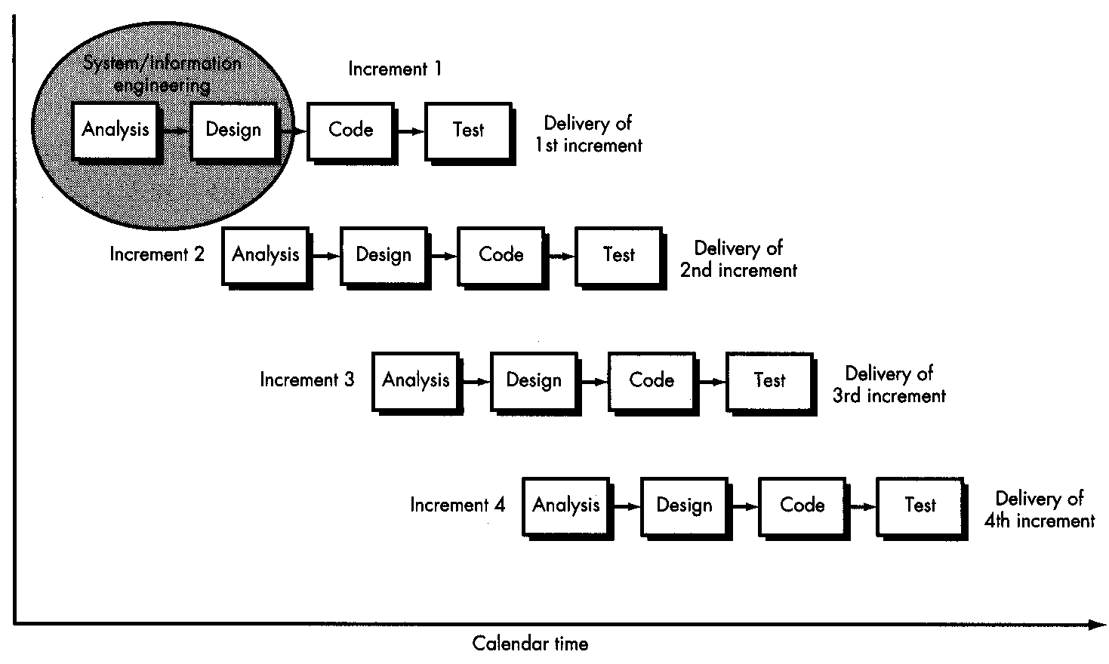
Incremental Model

Slide 8
The Spiral Model
Iterative nature of prototyping with the controlled and systematic aspects of the linear sequential model
For example:
  First circuit: specification
  Second circuit: prototype
  Third circuit: product release
  Fourth circuit: product maintenance
A spiral model is divided into a number of framework activities

Slide 9
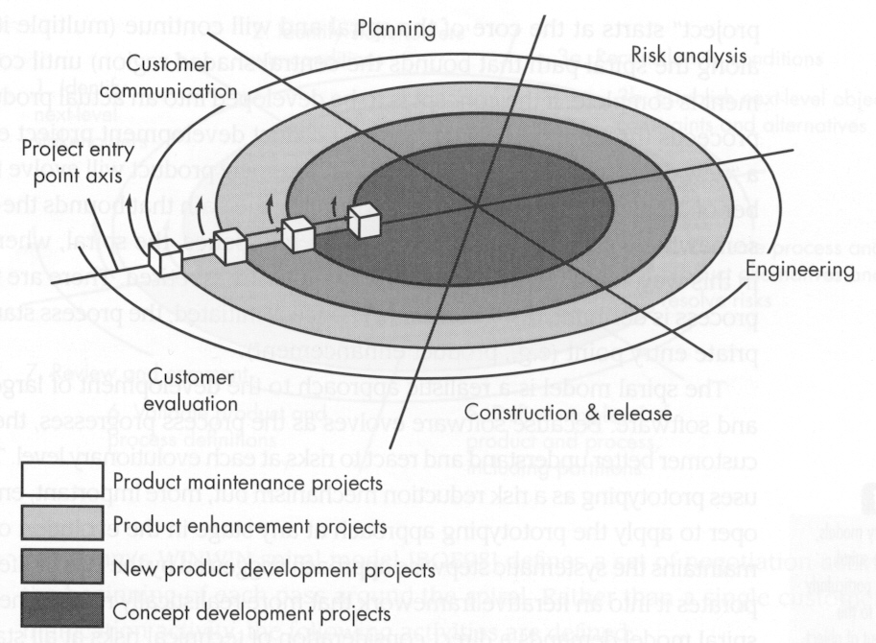
Spiral Model
A spiral models is divided into a number of framework activities, also called task regiong.
Task required to construct, test, install, and provide user support
Task required to define resource, timelines, and other project related information.
Task required to establish effective communication between developer and customer.
Task required to assess both technical and other project-related information.
Task required to build one or more representations of the application.
What is a “task set”?

Slide 10
The Spiral Model (2)
Challenges:
  Hard to show controllability
  (size and timing of each circuit)
  Risk assessment is fundamental
  Model fairly new (less experience)

Slide 11
WINWIN Spiral
A variation of the standard Spiral Model
Identify key “stakeholders”
Determine stakeholder win conditions
Reconcile win conditions into a set of win-win conditions for the whole project
Win-Win Spiral Model (eliciting software requirements defined through negotiation between customer and developer, where each party attempts to balance technical and business constraints)

Slide 12
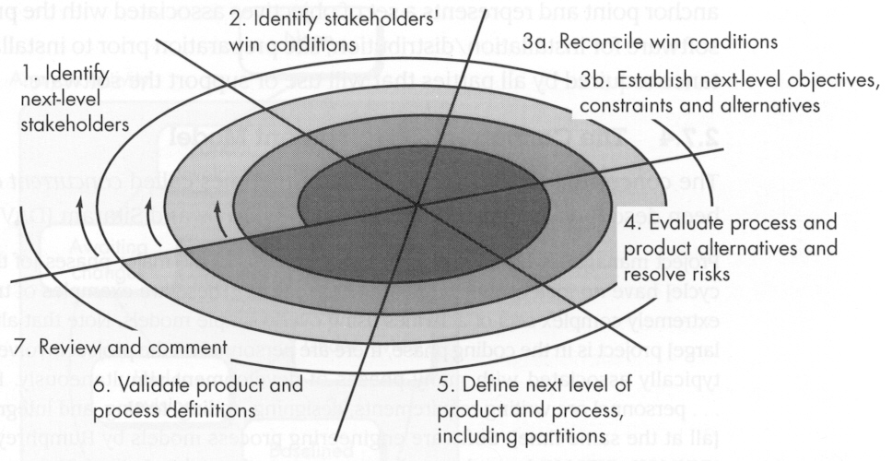
WINWIN Spiral

Slide 13
Concurrent Development
State charts for each activity
Events trigger state transitions
Useful for inter organizational development
Useful where there is a high degree of interdependence between different modules
(e.g., client-server apps)
Concurrent Development Model (similar to spiral model often used in development of client/server applications)

Slide 14
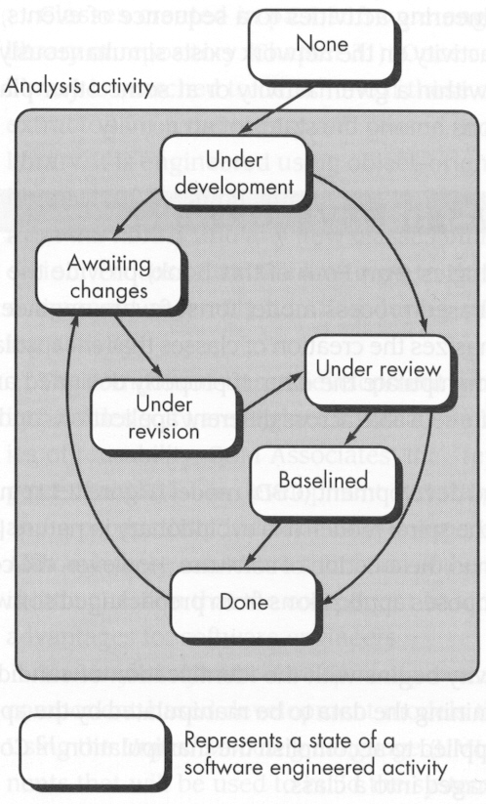
Concurrent
Development
Model

Slide 15
Component Assembly Model
Spiral Model, plus object-oriented reusability
Challenges:
  Reusability requires careful planning
  Most existing programs are not reusable
  More suitable for particular application domains
  (with significant patterns of reuse)
Component-Based Development (spiral model variation in which applications are built from prepackaged software components called classes)

Slide 16
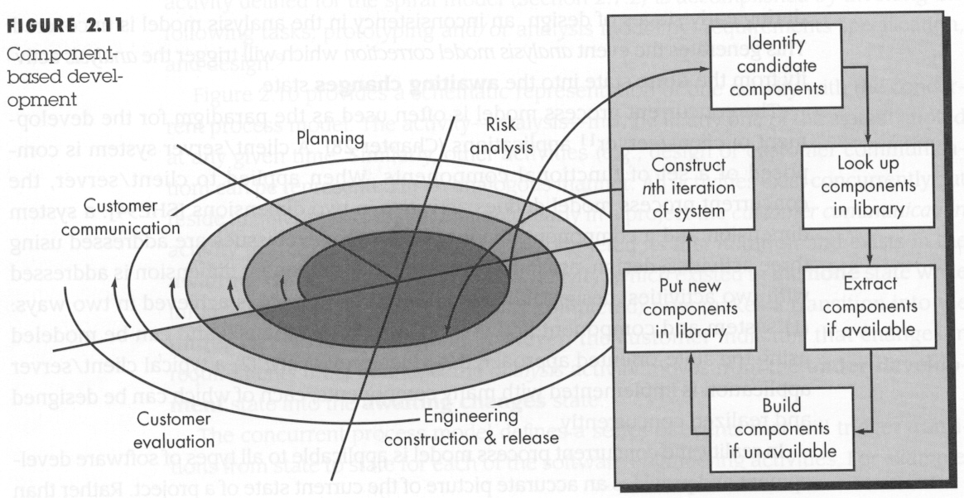
Component Assembly

Slide 17
Other Models
Formal Methods
  Rigorous mathematical (logical) specification of software
  Formal models are time-consuming
  Requires developer, customer skill
Fourth Generation Techniques
  High-level definition language
  E.g., UML -> Java code generation
  Benefits small/midsize projects most
Formal Methods Model (rigorous mathematical notation used to specify, design, and verify computer-based systems)
Fourth Generation (4GT) Techniques (software tool is used to generate the source code for a software system from a high level specification representation)

